Slide 1
Global Population changes 1970-2050
UCSD Data Science and Visualization 2020
Group Project #1
Group Members: Mika Nagamine, Nick Theriot, Ian Rao, Emily Akemann

Slide 2

Purpose:
To explore populations through time in different regions of the world
To compare various population distribution/profiles between those regions focusing on:
Overall growth/decline of age groups as % of total population
Fertility rates per region
Changes in demographic makeup between urban and rural populations
Source Data: The World Bank

Slide 3
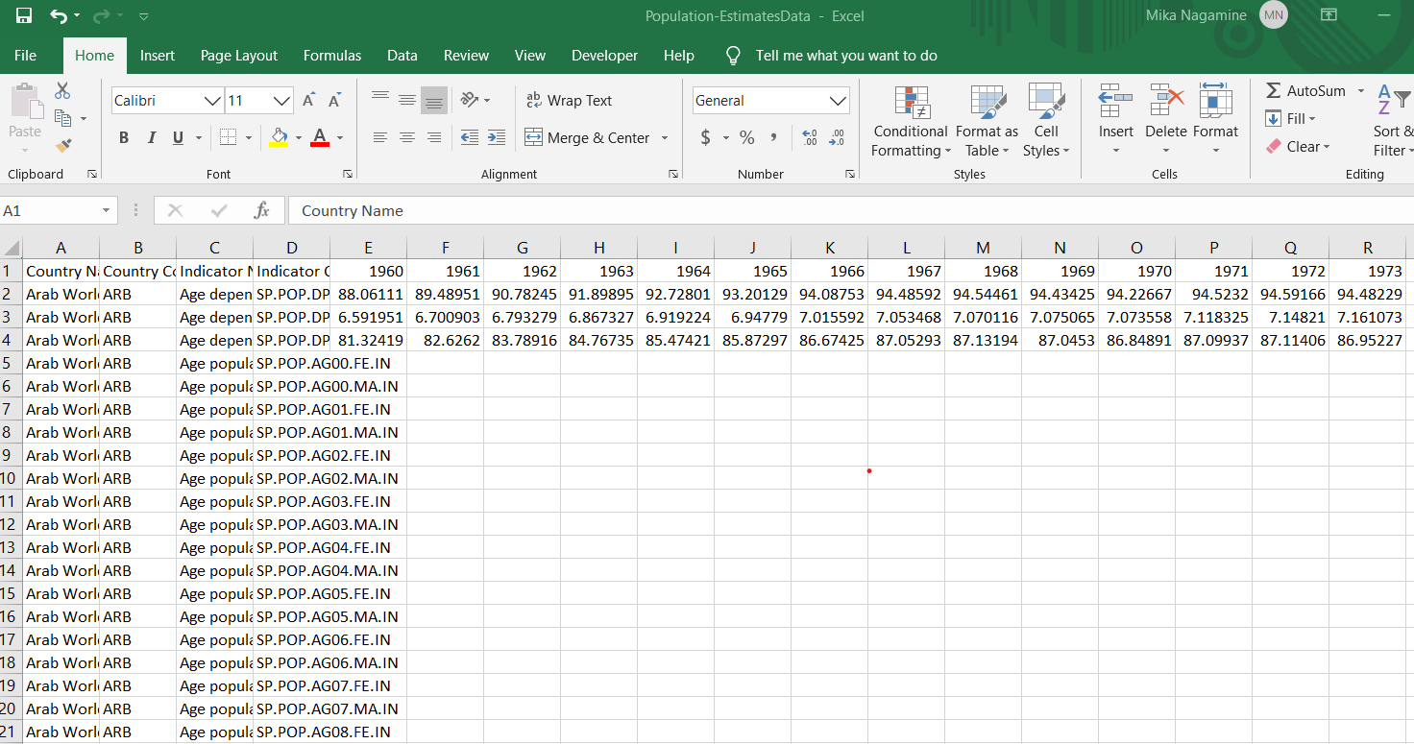
Data Cleaning Challenge
45,000 rows, 85 columns, many missing values, and lots of rows and columns that we don’t need.

Slide 4
Our Questions:
What does the population distribution between different regions of the world look like from 1970 through 2020, as well as estimates through 2050?
How does the population distribution among age groups differ between 1970-2020?
How does the fertility rate change between regions 1970-projected 2050?
How does the Urban and Rural total population distributions of the 8 regions analyzed look like along with the annual percent population growth rate between 1970-2020?

Slide 5
Question 1:
What does the population distribution between different regions of the world look like from 1970 through 2020, as well as estimates through 2050?

Slide 6
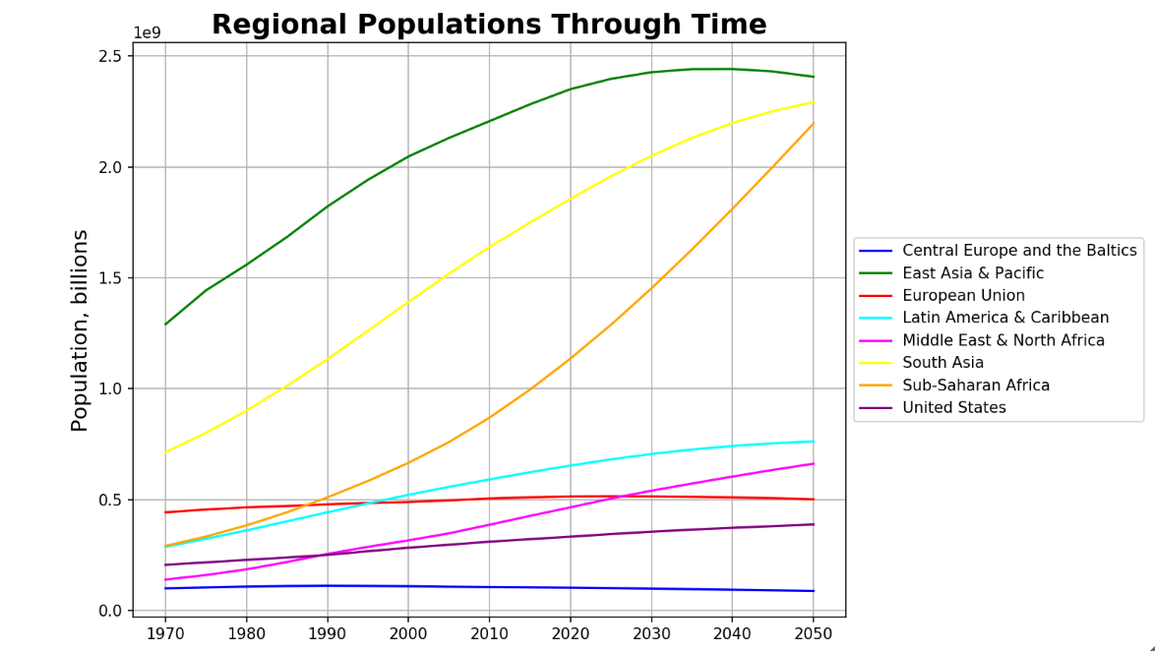
East Asia and the Pacific, South Asia, and Sub Saharan Africa lead the charge in future global population growth
However East Asia and the Pacific does level off with just under 2.5billion people by 2030.
The European Union and Central Europe and the Baltics see little to no population growth in the last fifty years, nor are they projected to in in the next thirty.
The U.S. also only increases nominally 1970-2050, and Latin America and the Caribbean levels off by 2040.

Slide 7
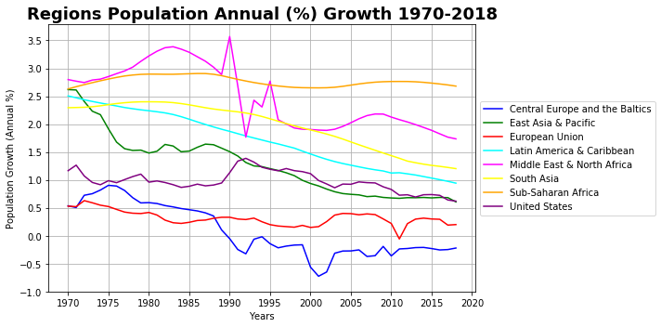
Nearly all regions have a decline in growth rate over the last fifty years
The Central Europe and Baltics is the only region to experience negative annual growth for an extended period from 1990 until 2018
Overall most regions experienced continuous annual population growth at varying rates as time went on barring any extreme conditions.

Slide 8
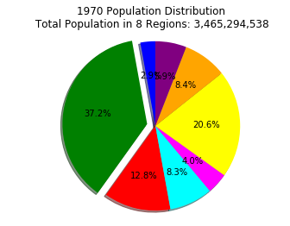
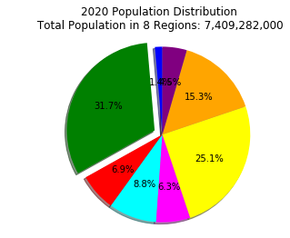
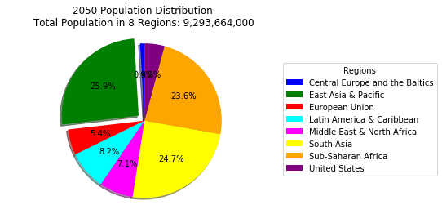
East asia and the pacific maintains the largest % of total population between 1970, 2020, & projected 2050, however Sub-Saharan Africa continues to grow
Overall, 94% - 96% of the world population is in 8 regions between 1970 and 2050.
Ex: 7.8 billion people are on Earth in 2020 - among them, 7.4 billion are in these 8 regions.
In 1970, the greatest population centers were primarily in Asian countries, followed by European Union.
In 2020 Asian regions are still the most populated area, however now the European Union as shrunk to one of the smallest, while Sub-Saharan Africa has nearly doubled.
2050 projections show all regions maintaining or shrinking their size as a % of total population, except for Sub-Saharan Africa which continues to grow.

Slide 9
Question 2:
How does the population distribution among age groups differ between 1970-2020?

Slide 10
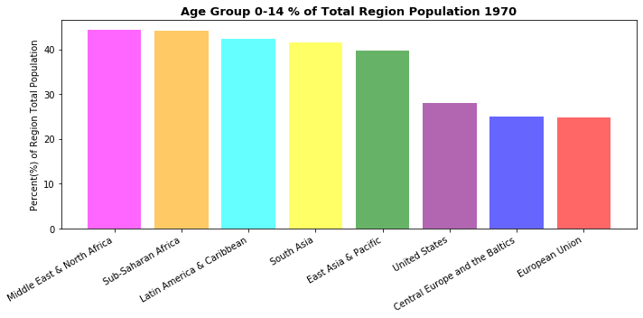
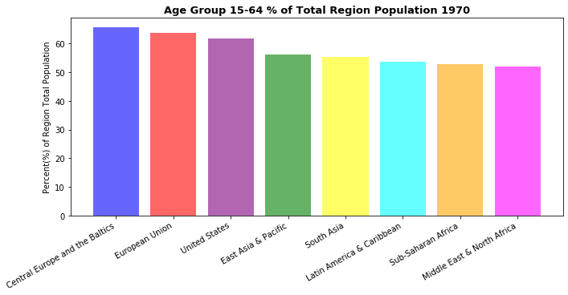
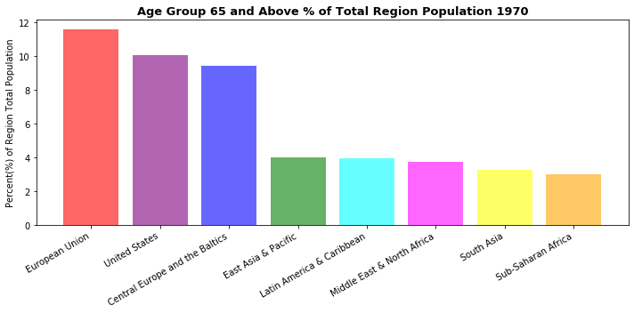
The Middle East & African regions had some of the youngest populations in 1970, while the European union has the oldest
The United States, EU, and Central Europe and the Baltics regions make up the 3 largest percentages both in the 15+ and 65+ age groups.
All regions have a small percentage of 65+ age group populations in comparison to the other two age groups.

Slide 11
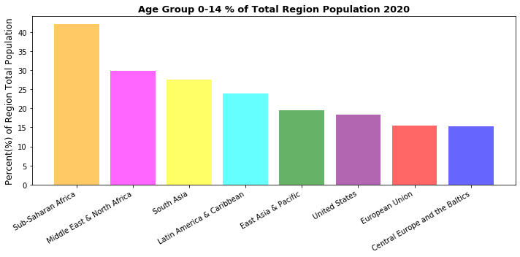
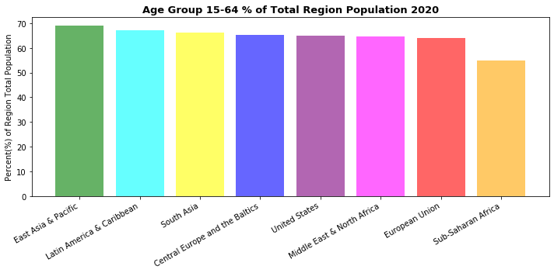
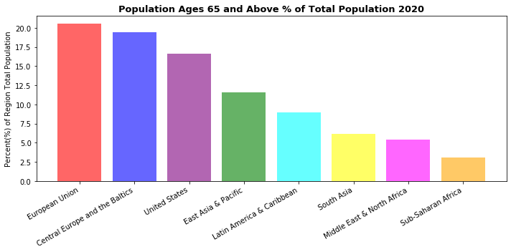
In 2020 we see a significant increase in elderly Populations
Sub-Saharan Africa maintains its population distributions over the last fifty years between young, middle, and elderly populations
The European Union, Central Europe and the Baltics, and United States continue to have some of the largest 65+ populations.
We also observe a decrease in percentages across the 0-14 age group across all regions besides Sub-Saharan Africa.

Slide 12
Question 3:
How does the fertility rate change between regions 1970- projected 2050?

Slide 13
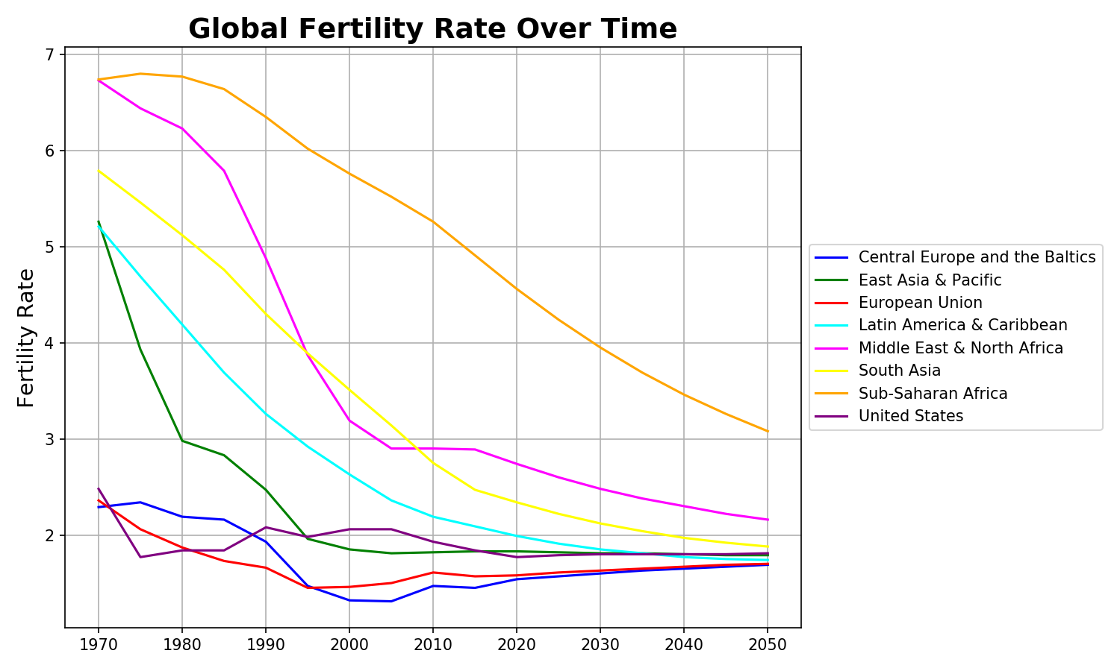
Fertility rates (total births per woman) decline dramatically 1970-2000
However fertility remains steady between 1.5-2 children per woman for most regions by around 2020 with South Asia not far behind.
East Asia & the Pacific has the most dramatic drop with just over 5 children per woman in 1970, to less than two children just thirty years later in 2000.
Western countries are at two or less children per woman by 1990.
Fertility Rate (Total Births per Woman)

Slide 14
Question 4:
How does the urban and rural total population distributions of the 8 regions analyzed look like along with the annual percent population growth rate between 1970-2018?

Slide 15
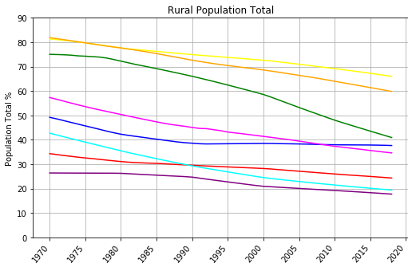
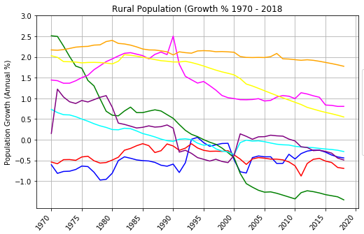
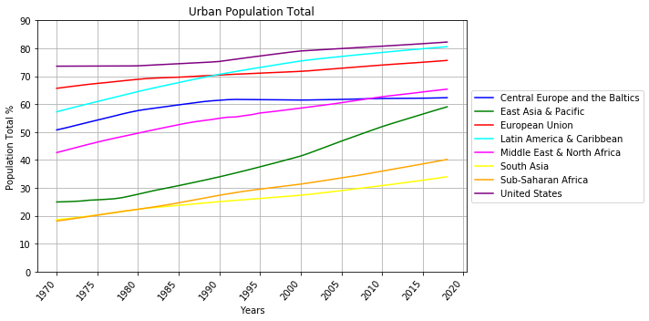
More People are Leaving Rural Areas and heading to urban areas Just about all regions saw their rural population as a % of their total population decline between 1970-2018
The East Asia & Pacific is the region with the most dramatic change in people leaving rural areas with some of the highest growth rate in 1970, to the lowest (negative) growth of all the regions in 2018.
The European Union and Central Europe and the Baltics have always had negative growth 1970-2018, however Central Europe and the Baltics maintains their rural population as a % of their total population beginning around 1990.
The European Union and United States also see a much slower decline in their rural population as a % of their total population.
Sub Saharan Africa maintains about the same rural growth 1970-2018, however their total rural population continues to decline.

Slide 16
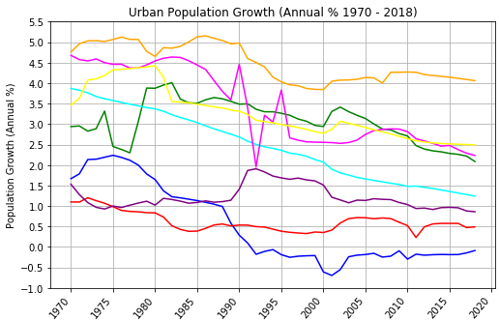
More People are Leaving Rural Areas and heading to urban areas Just about all regions grew their urban population as a % of their total population between 1970-2018
Central Europe and the Baltics however maintained their urban population as a % of their total population beginning around 1990
We also saw their rural population as a % of their total population stay the same after 1990, suggesting this region has had the least movement between cities and rural areas in the last thirty years
Sub-Saharan Africa, the Middle East & North Africa, The European Union, and Central Europe and the Baltics have mostly maintained their urban population growth rate since about 2000

Slide 17
In conclusion…

Slide 18
Summary/Takeaways
Though the world population continues its steady growth through 2050, aging populations and low fertility rates in some countries will see populations in those regions decline or remain steady.
Populations in most regions will continue to see their urban populations grow to the detriment of their rural regions.
Country governments should track their population movements closely to be able to make policy decisions.

Slide 19
Limitations/biases in this data set
The data we worked with only had eight regions and we do not know which countries are included in which region grouping. Because of this, we are missing Australia, Canada, New Zealand, some island nations, and a few other countries which caused our quantitative data set to be slightly limited.
We expected to see urban annual % growth continue for all regions while rural areas declined, however most regions actually saw urban annual % growth decline or remained steady while just the total populations grew (likely due to those already living there or immigration).
Since there were only two choices – urban and rural, growth/decline mirrored one another. If there was a third choice, say, mid-sized towns, we may not have seen such an inverse relationship.

Slide 20
Questions?

